Slide 1


UI5 Globalization
Jerry Wang
2016 April
Internal
Notes:
30 minutes

Slide 2
Fiori Globalization Overview
All Globalization requirement could be implemented by API provided by UI5 framework. The aim are:
Ensure a consistent formatting across the applications
Reduce Application development cost
Notes:
https://wiki.wdf.sap.corp/wiki/display/fiorisuite/Globalization

Slide 3
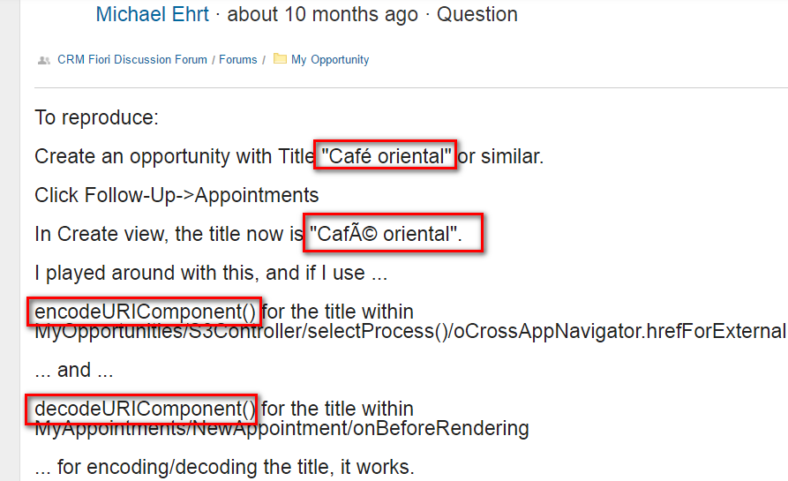
Unicode compliance
The target is, that any textual data is transmitted and processed properly.
See one issue raised by our customer, ERCO:

Slide 4
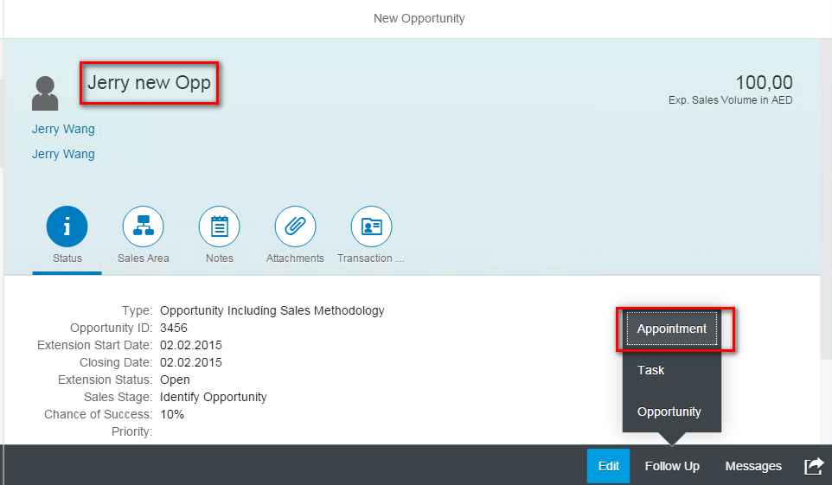
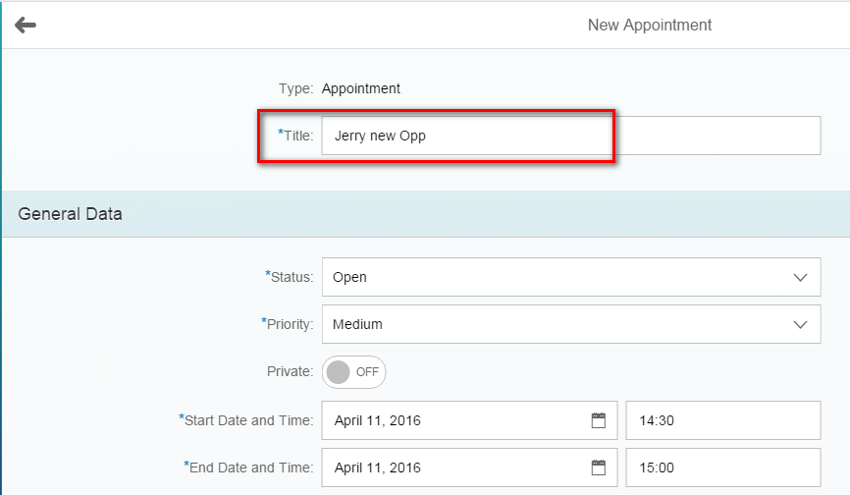
Follow-up Scenario

Slide 5
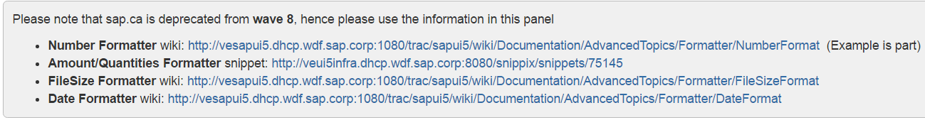
Numbers, Amounts, Quantities, File Size, Dates Formatting

Slide 6
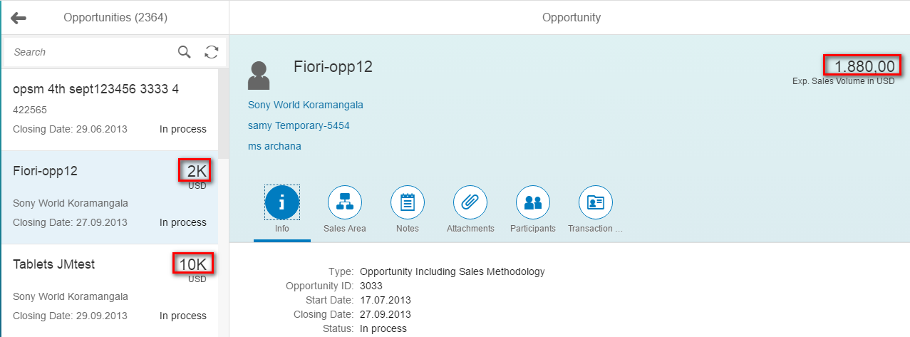
Number Format
Example: GM4/001

Slide 7
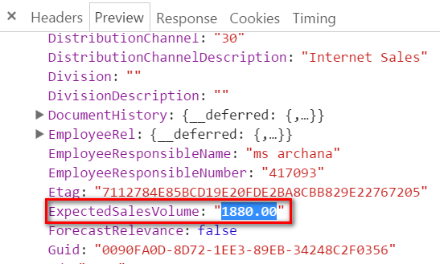
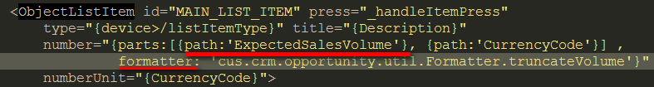
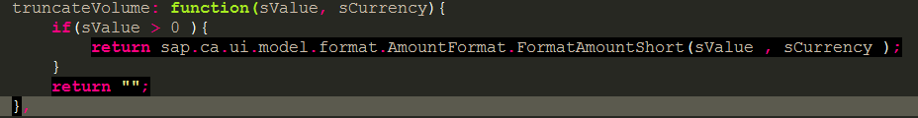
How is this 1880.00 formatted as 2K?

Slide 8
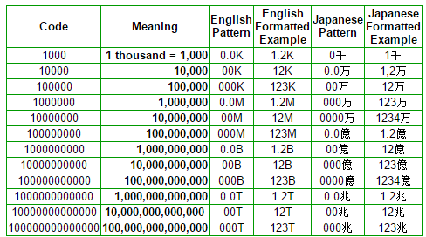
CLDR - Unicode Common Locale Data Repository
The Unicode CLDR provides key building blocks for software to support the world's languages, with the largest and most extensive standard repository of locale data available. This data is used by a wide spectrum of companies for their software internationalization and localization, adapting software to the conventions of different languages for such common software tasks.

Slide 9
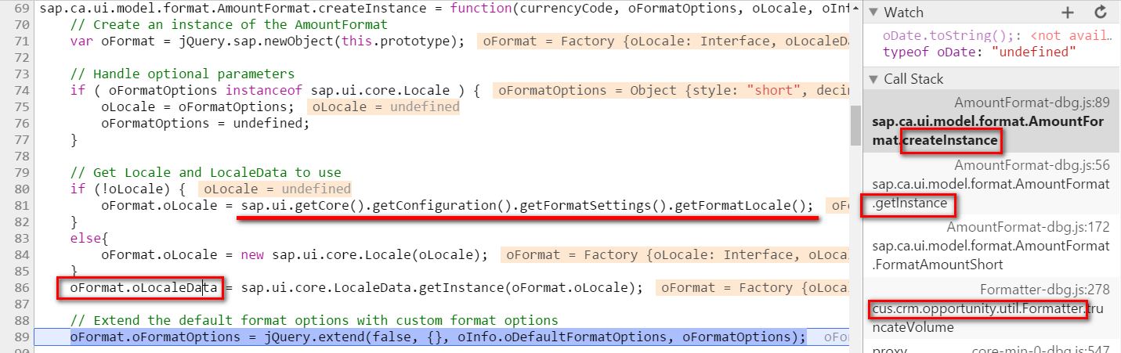
Locale Specific Format Data

Slide 10
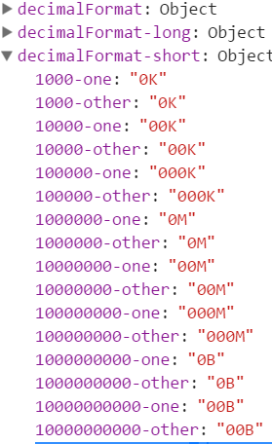
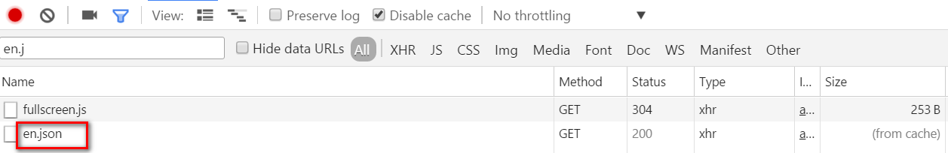
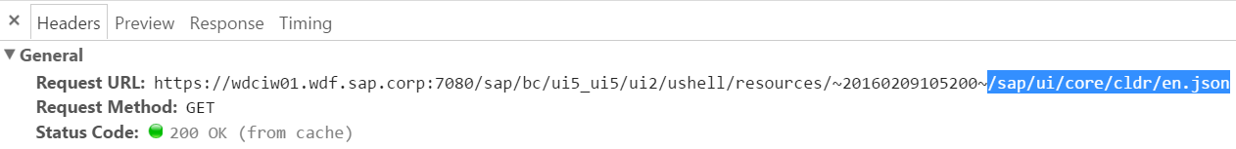
oFormat.oLocaleData

Slide 11
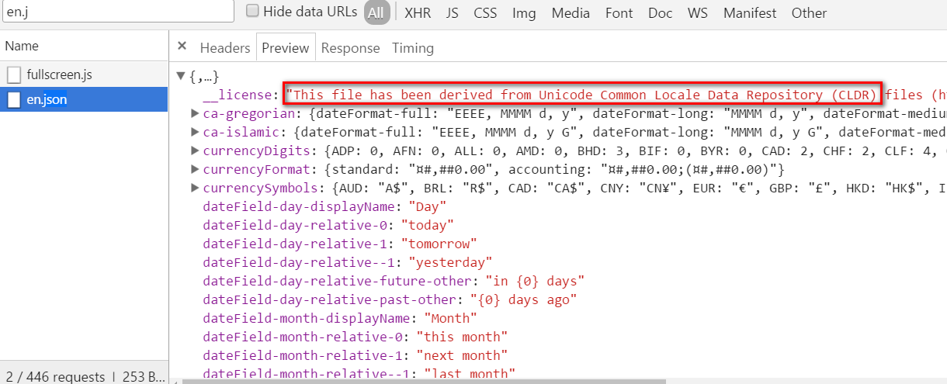
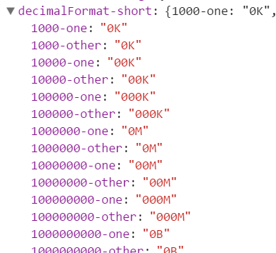
en.json
Notes:
https://wdciw01.wdf.sap.corp:7080/sap/bc/ui5_ui5/ui2/ushell/resources/~20160209105200~/sap/ui/core/cldr/en.json

Slide 12
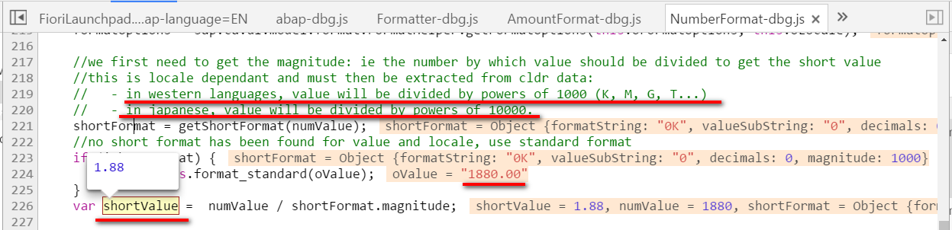
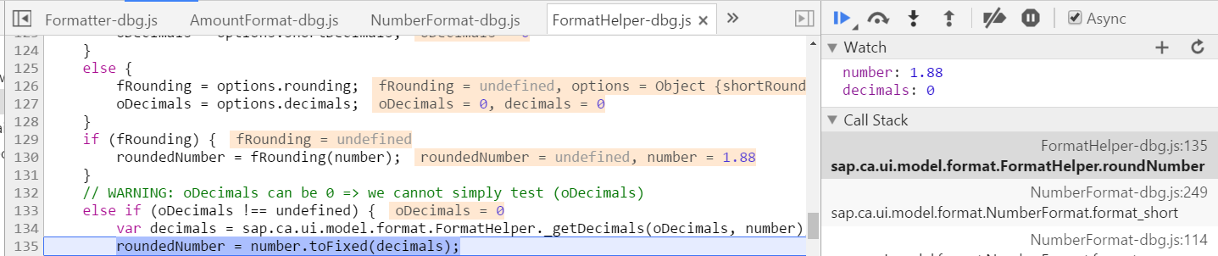
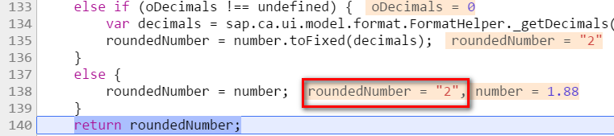
How is “1880” formatted to “2K”

Slide 13
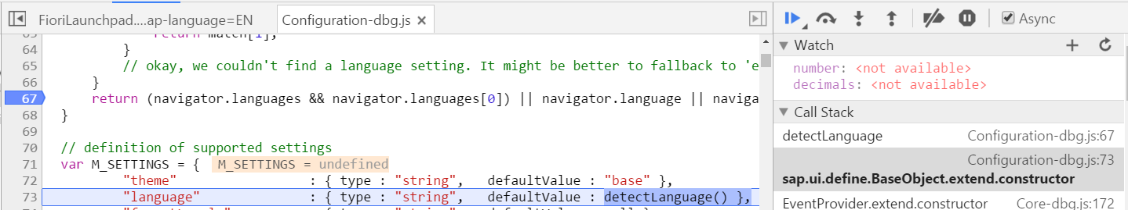
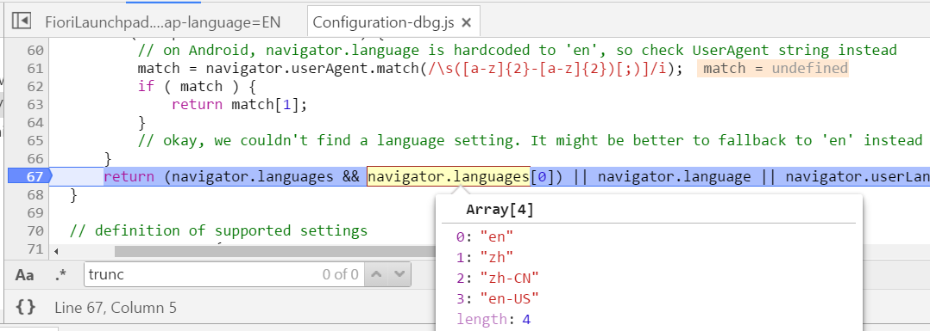
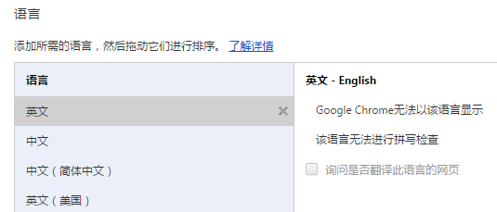
How is English version of CLDR loaded

Slide 14
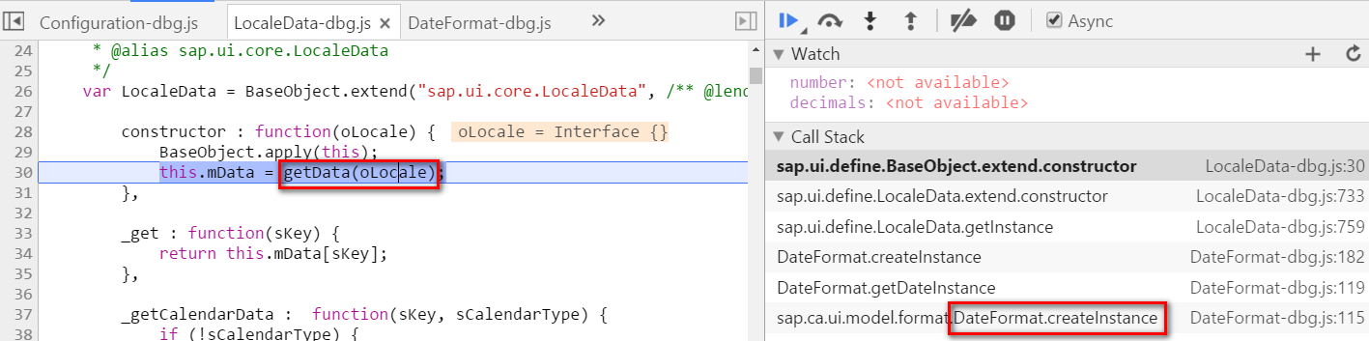
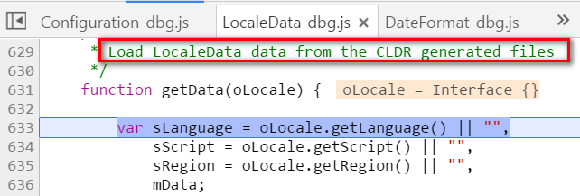
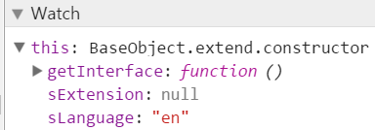
Load CLDR file according to Language

Slide 15
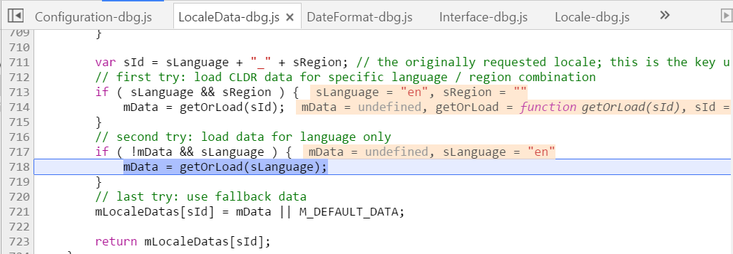
Load CLDR file according to Language ( 2 )

Slide 16
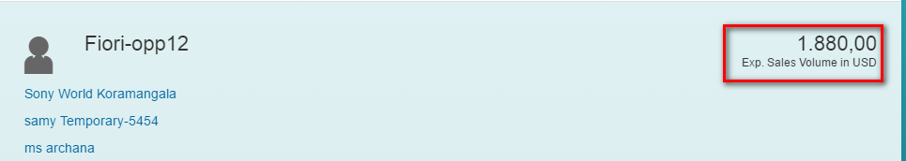
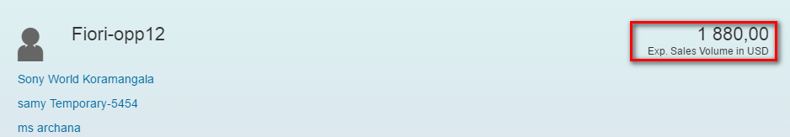
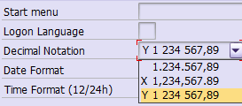
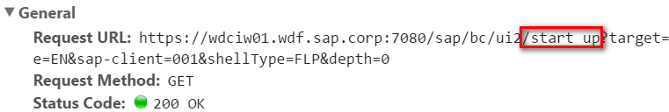
Number Format ( 2 )
Notes:
Jerry 2016-03-04 15:13PM – format is determined by gateway system setting, not CRM backend.

Slide 17
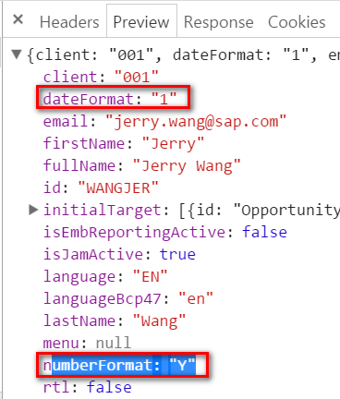
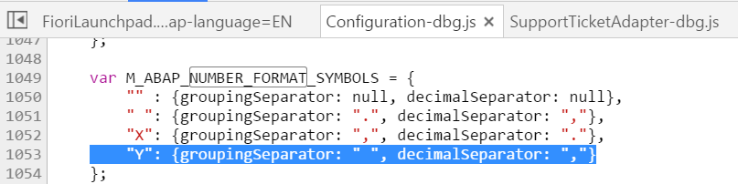
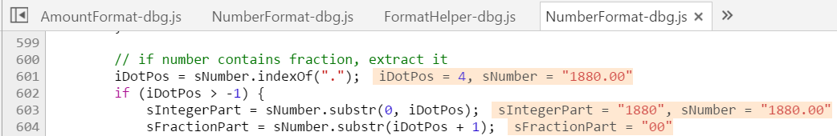
How is “1880” formatted to “1880,00”

Slide 18
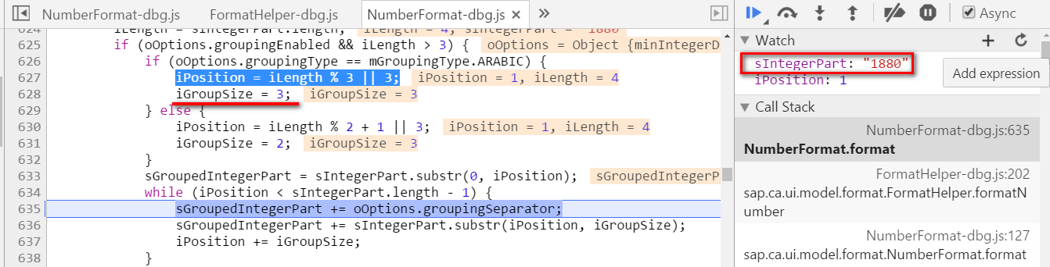
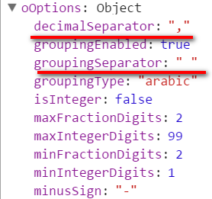
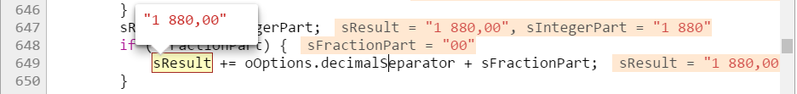
oOptions

Slide 19
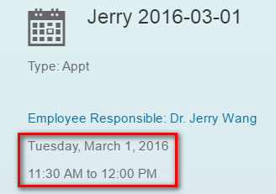
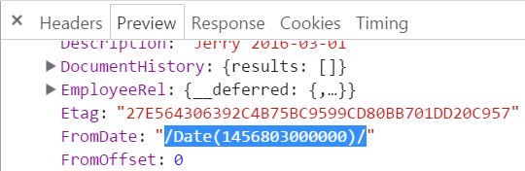
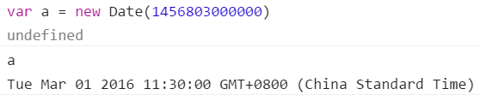
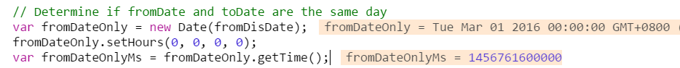
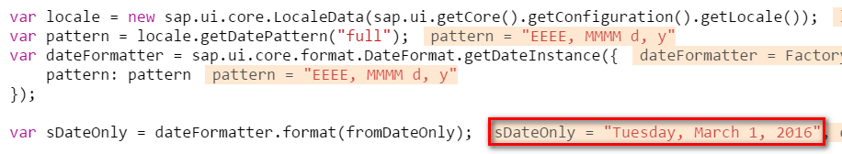
Date Format

Slide 20
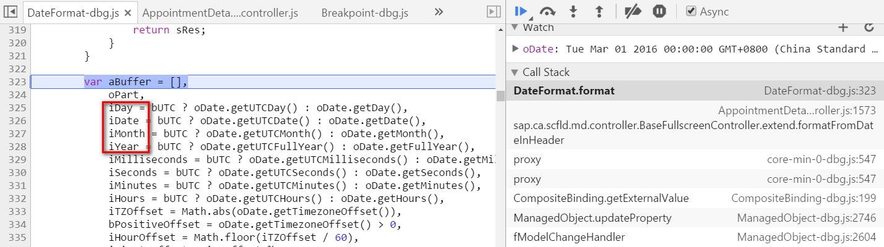
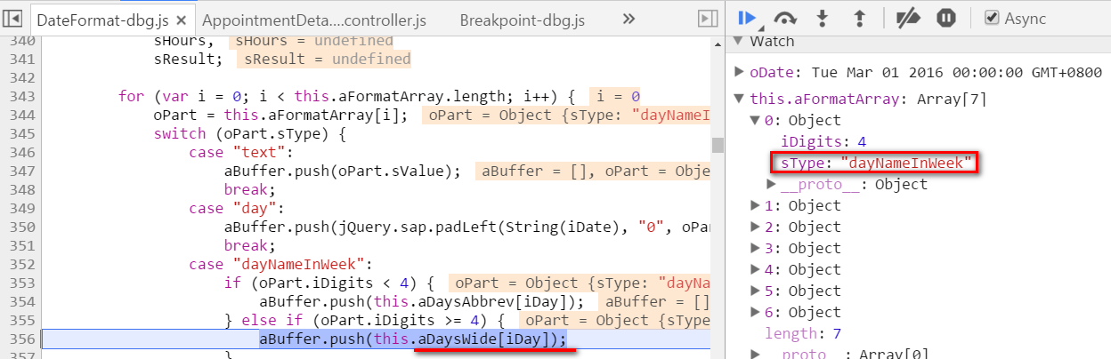
How is Date formatted

Slide 21
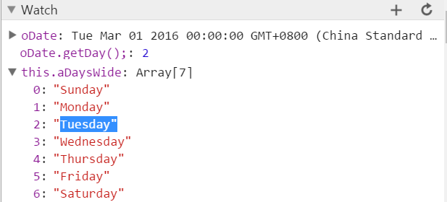
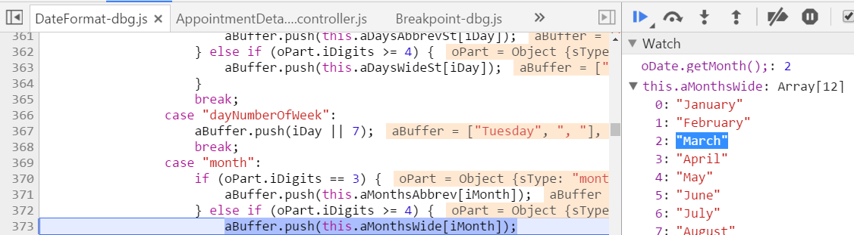
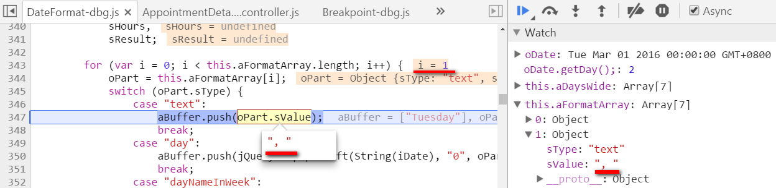
How is Date formatted (2)

Slide 22
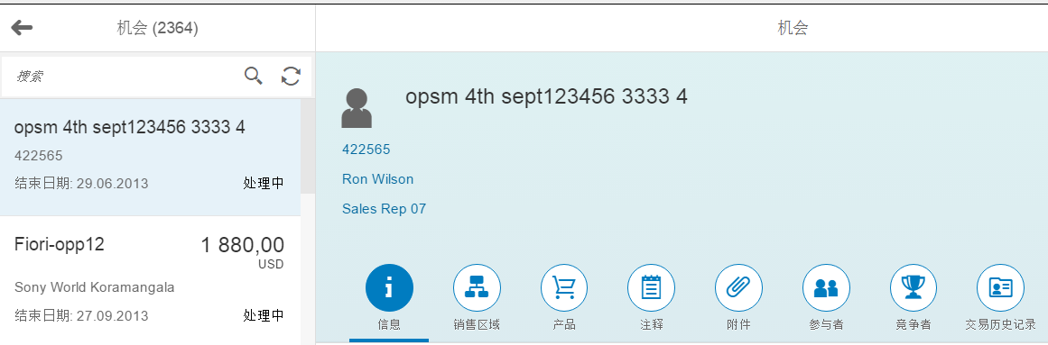
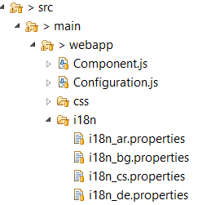
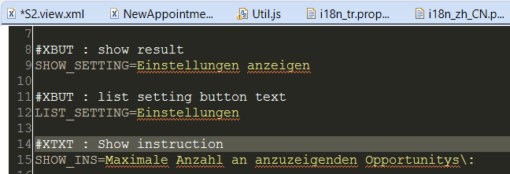
Internationalization

Slide 23
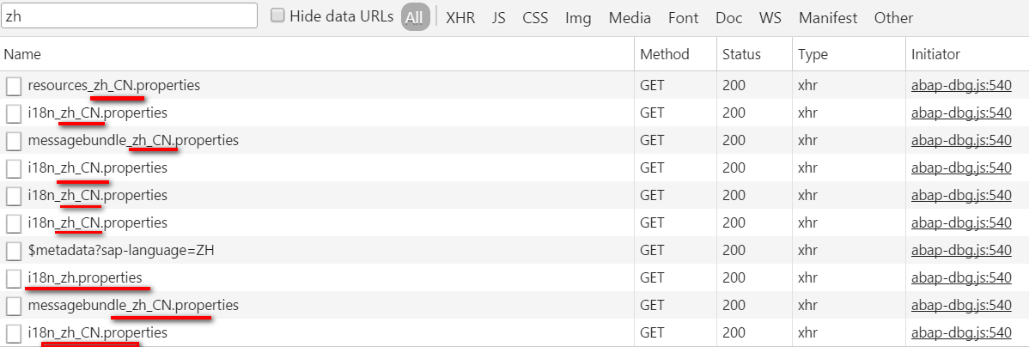
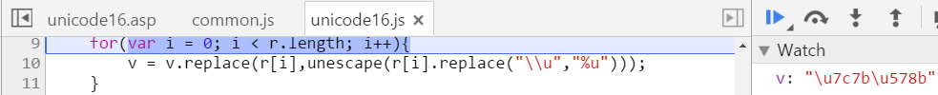


Use case 1
Notes:
https://wdciw01.wdf.sap.corp:7080/sap/bc/ui5_ui5/ui2/ushell/resources/~20160224095200~/sap/ushell/renderers/fiori2/resources/resources_zh_CN.properties
https://wdciw01.wdf.sap.corp:7080/sap/bc/ui5_ui5/ui2/ushell/resources/~20160224095200~/sap/ca/ui/i18n/i18n_zh_CN.properties
https://wdciw01.wdf.sap.corp:7080/sap/bc/ui5_ui5/ui2/ushell/resources/~20160224095200~/sap/m/messagebundle_zh_CN.properties
https://wdciw01.wdf.sap.corp:7080/sap/bc/ui5_ui5/sap/crm_opprtnty/~EA5BAEC9B3D024A3C0A35A27EEEB62EB~5/i18n/i18n_zh_CN.properties
https://wdciw01.wdf.sap.corp:7080/sap/bc/ui5_ui5/sap/crm_opprtnty/~EA5BAEC9B3D024A3C0A35A27EEEB62EB~5/i18n/i18n_zh_CN.properties
https://wdciw01.wdf.sap.corp:7080/sap/bc/ui5_ui5/ui2/ushell/resources/~20160224095200~/sap/ca/scfld/md/i18n/i18n_zh_CN.properties
https://wdciw01.wdf.sap.corp:7080/sap/bc/ui5_ui5/sap/crm_opprtnty/~EA5BAEC9B3D024A3C0A35A27EEEB62EB~5/i18n/i18n_zh.properties
https://wdciw01.wdf.sap.corp:7080/sap/bc/ui5_ui5/ui2/ushell/resources/~20160224095200~/sap/ui/layout/messagebundle_zh_CN.properties
https://wdciw01.wdf.sap.corp:7080/sap/bc/ui5_ui5/sap/crm_lib_reuse/sap/cus/crm/lib/reuse/~3FB0C1F4B1094973FE4A2909D0D79C10~5/i18n/i18n_zh_CN.properties
https://wdciw01.wdf.sap.corp:7080/sap/bc/ui5_ui5/ui2/ushell/resources/~20160224095200~/sap/ui/unified/messagebundle_zh_CN.properties
\uxxxx这种格式是Unicode写法，表示一个字符，其中xxxx表示一个16进制数字，范围所0～65535. Unicode十六进制数只能包含数字0～9、大写字母A～F或者小写字母A～F。需要注意到是：Unicode的大小端问题，一般都是小端在前，例如 \u5c0f 表示汉语中的 '小'字，转换成10进制就是9215，所以在byte数组中应该是1592.

Slide 24


Use case 2
this.oResourceBundle = sap.ca.scfld.md.app.Application.getImpl().getResourceBundle();

Slide 25

RTL support

Slide 26

RTL support

Slide 27



Dedicated CSS style for RTL=true
Notes:
https://wdciw01.wdf.sap.corp:7080/sap/bc/ui5_ui5/ui2/ushell/resources/~20160224095200~/sap/ui/core/Core-dbg.js
url: /sap/bc/ui5_ui5/ui2/ushell/resources/~20160224095200~/sap/fiori/themes/sap_bluecrystal/library-RTL.css

Slide 28



Layout DOM element with CSS style float:right

Slide 29


RTL support implementation
Notes:
getRTL： ui5_ui5/ui2/ushell/resources/sap/ui/core/Configuration.js
Html class: sapUShellFullHeight sap-desktop sapUiMedia-Std-Desktop sapUiTheme-sap_bluecrystal
Body: sapUiBody sapUShellFullHeight

Slide 30
Further Information
https://sapui5.netweaver.ondemand.com/sdk/#docs/guide/91f2c24b6f4d1014b6dd926db0e91070.html
https://wiki.wdf.sap.corp/wiki/display/unifiedshell/CSS+and+.less+guidelines++in+Fiori+Launchpad
https://wiki.wdf.sap.corp/wiki/display/fiorisuite/Globalization
http://veui5infra.dhcp.wdf.sap.corp:8080/uilib-sample/test-resources/sap/ui/core/Formats.html?sap-ui-debug=true&sap-ui-language=en-US&sap-ui-accessibility=true&sap-ui-jqueryversion=1.11.1&sap-ui-theme=sap_bluecrystal
https://wiki.wdf.sap.corp/wiki/display/SAPUI5/NumberFormat
https://wiki.wdf.sap.corp/wiki/pages/viewpage.action?pageId=1697164258
http://scn.sap.com/community/developer-center/front-end/blog/2015/11/27/understanding-rtl-language-support-in-sapui5
Notes:
URL parameter sap-ui-rtl=true
Configuration object: window["sap-ui-config"].rtl = true;
Script tag configuration: data-sap-ui-rtl="true"

